Slide 1
sdmay19-33:
Availability Prediction Based on Multi-Context Data
Group Members:
Tristan Anderson, Noah Chicchelly,
Shane Impola, Brendon McGehee,
Nick Schmidt, and Justice Wright
Advisor/Client: Dr. Goce Trajcevski
Notes:
1-3 Noah
4-6 Justice
7-9 Tristan
Nick is doing diagram slides (maybe schedule)
Brenden is doing Hardware slide (maybe schedule/next semester)
Shane (Why we chose what/contributions/leftover)
Thank you all for being here, we are senior design group 33. Our project is Availability Prediction, based on multi context data. I’m noah, this is etc.

Slide 2
Problem Statement
Improve the estimation of restaurant wait-times.
Current restaurant wait times:
Location based
Unreliable
Incapable of real-time adjustments
Provide value solely to potential customers
Our design aims at enabling:
Higher accuracy
Update with real-time information
Increased information accessibility
Increased time efficiency
Notes:
Our problem statement was to improve the estimation of restaurant wait times. The current wait time solution is location based, unreliable, incapable of RT adjustments, and provides info to solely customers. Our project is integrated within the restaurants themselves. So our design aims to enable higher accuracy, update with RT info, give increased info accessibility to customers, as well as increased time efficiency for employees.

Slide 3
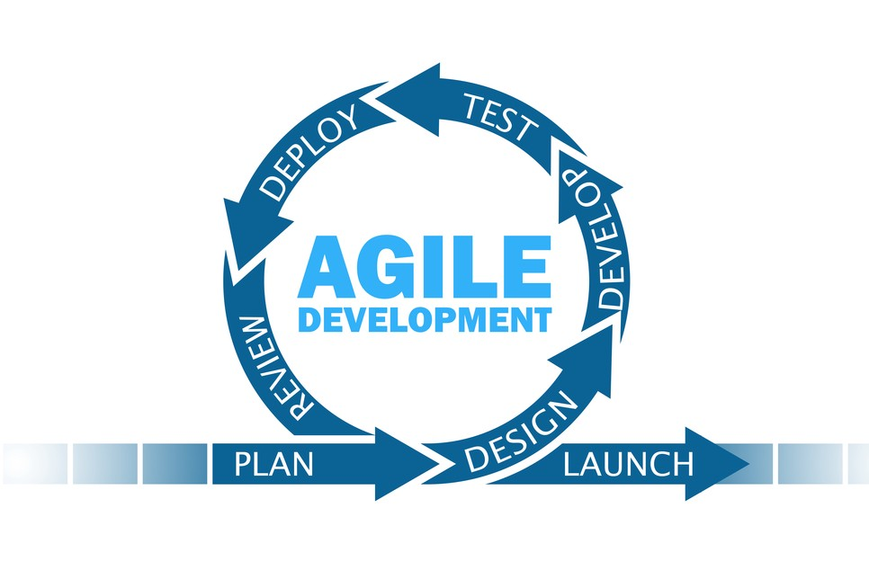
Design Approach
Cross-discipline development
Methodology selection
Sub-Teams
Hardware -Brendon/Justice
Backend - Noah/Shane
Frontend - Nick
Network - Tristan
Client/Advisor integration
Notes:
Due to the nature of our project, we required electrical, computer, and software engineers working in unison. This helped inform our methodology selection. With agile we were able to work as subteams, all in parallel. As opposed to other methodologies suchas waterfall which would’ve slowed down progress. As required by the course, we had weekly meetings with our advisor as well as meetings within our subteams.

Slide 4
Functional Requirements
Diner/General User:
Define location
View general wait time
View available seating
Table specific waits
Push notifications for availability updates
Employees:
General user features
Assign table zones
Display meal progress
Track orders
Activate/decommission tables
Manually enter external delays
Notes:
Read them out, “nick will touch on how these work shortly”

Slide 5
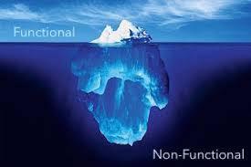
Non-Functional Requirements
Availability
Data integrity
Fault tolerance
Scalability
Usability
Notes:
Find graphic, animate?
Availability to cater to all users 24/7
Data integrity to ensure the data is legitimate
Fault tolerance to avoid one rogue node bringing down our system
Scalability for larger projects, restaurants and ventures
And Usability for streamlined, intuitive app design

Slide 6
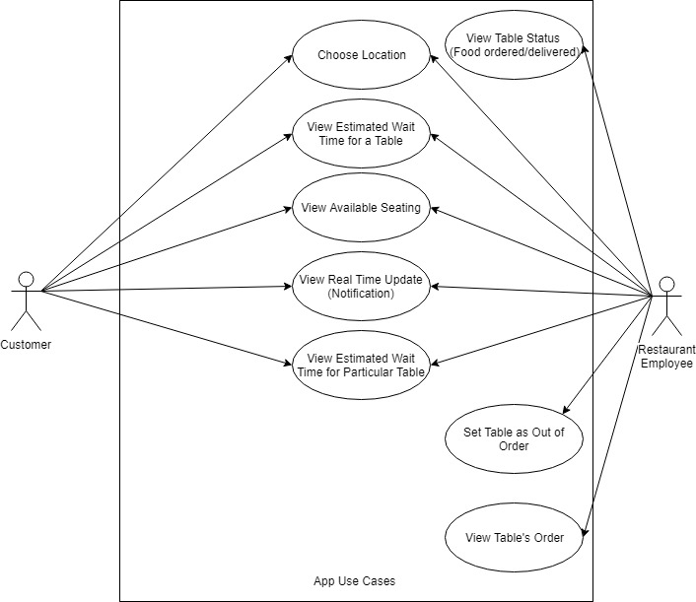
Functional Decomposition
Notes:
Highlight animation for each node to explain. Make picture bigger, no text

Slide 7
Constraints, Considerations, Standards
MySQL used to store raw data - Built in standards
Sensor durability
Assume implied consent
Customer use cases
Notes:
Mention some kind of standards (ex: SQL 2005)
Hint that we will talk about it later

Slide 8
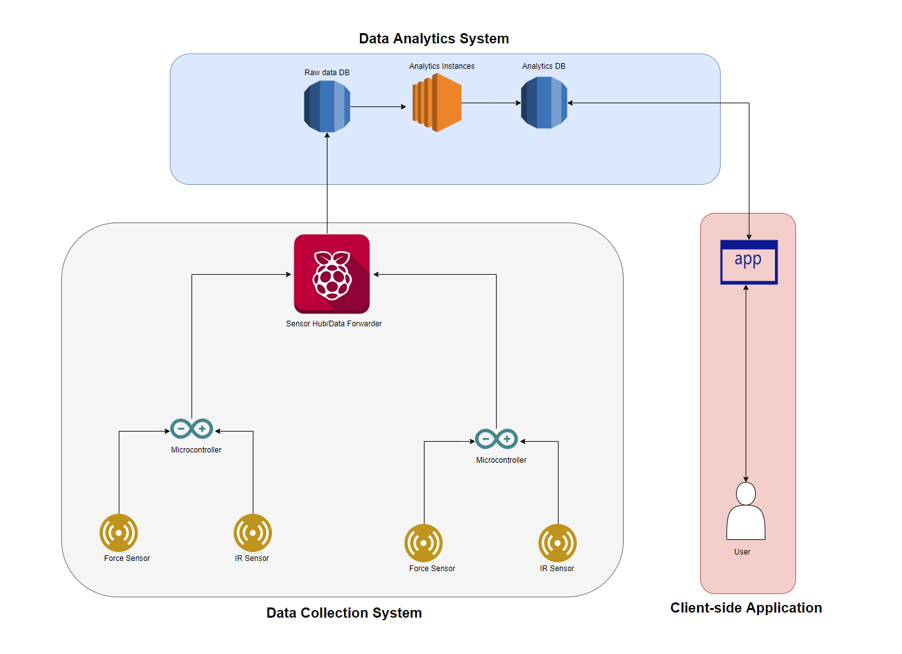
Conceptual Design
3 Subsystems
Sensor Nodes
AWS Data Storage and Analytics
Client-side Mobile Application
Sensor Nodes:
Microcontroller with sensors
Feed data to hub
Hub POSTS data to database
Database
Store sensor data
Feeds analytics streams
Output serves requests to app
Application (Mobile)
Requests/receives analyzed data
Neatly displays to user
Contains employee/customer specific settings
Notes:
Individualist / whole-sum of parts

Slide 9
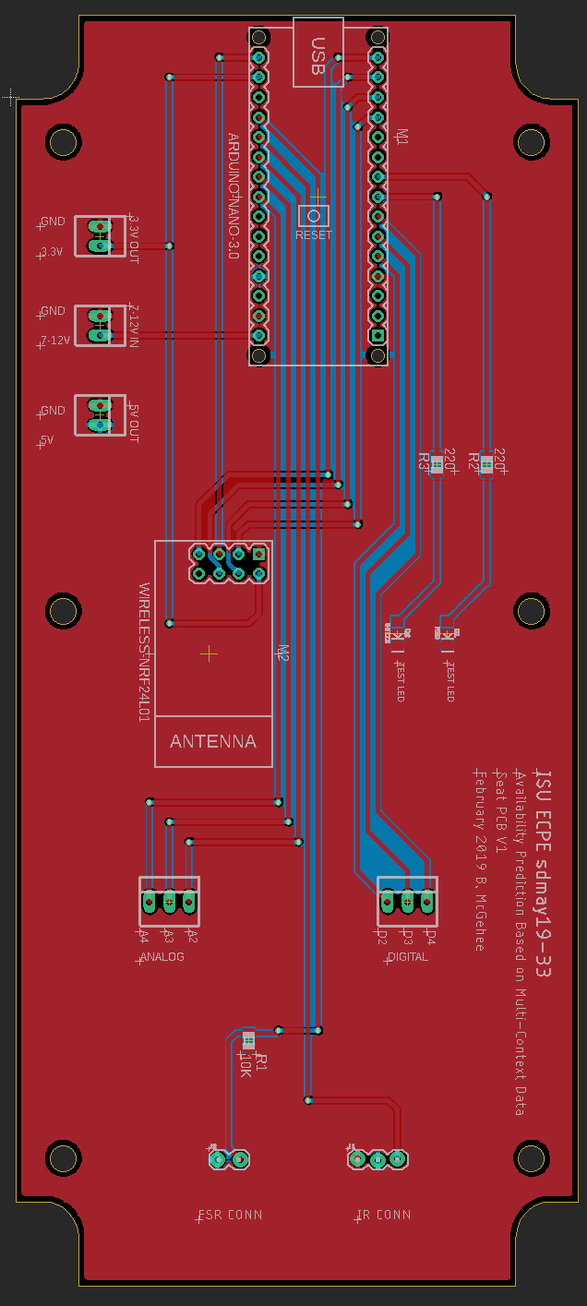
Platforms Used
1. Autodesk Eagle
Not industry standard but commonly used
Group member already had usage experience
2. Flutter as iOS and Android development platform
Cross platform development made easy
Offers high availability to all existing infrastructures
3. AWS as DB host
Industry standard
Free offerings more than enough for this project
Offers future expandability without migration issues
Notes:
Reiterate due diligence. (Why did we do AWS, mysql, oracle, etc)

Slide 10
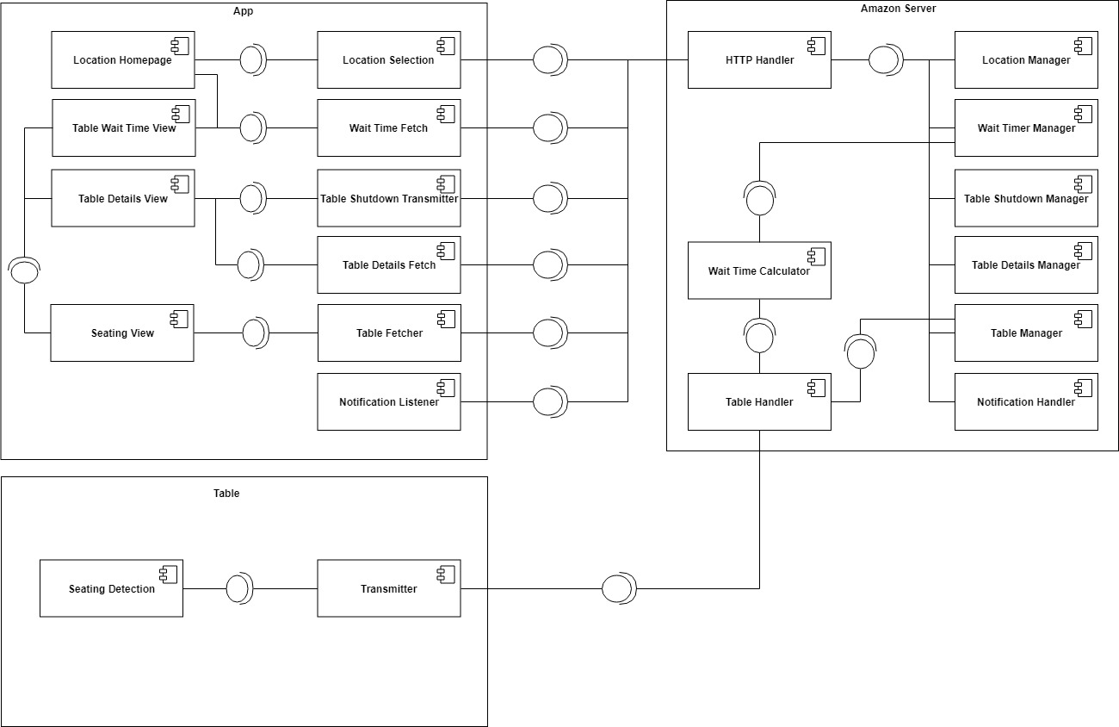
Detailed Design
Notes:
Highlight each box (not node) -- 3 total
Annotate any changes from last semester

Slide 11
Testing
Hardware Tests
Sensor testing to determine functionality
Arduino testing to determine correct data processing from sensors
Server Tests
Endpoint connectivity
Database functionality testing
App Tests
Data retrieval and interpretation
Functionality of application testing
Network Tests
Data Integrity
Interference
Notes:
Our test plan revolves around 4 major components, the first being hardware testing. The foundation of our project is data collection, so it is crucial that those data collection components are consistent and predictable.
To achieve this, there are two main areas of focus for testing, the functionality of the actual sensors, and the capability of the microcontrollers to collect and transmit this data correctly.
The second component is our server which will store and use our data to make predictions. The first piece of the server component is it’s availability to be written to by the microcontroller hub within the restaurant. The second is the ability for the server to communicate with the database to utilize the data.
The third component involves the high-level software piece of our project. The two parts that make up this component are the prediction algorithms that will utilize our collected data, and our front-end mobile application.
Lastly, the fourth component is the complete system. Since our project is based on some restaurant assumptions, it will be important to test different restauraunt enviornments to ensure expandability past our assumptions.
More details about specific tests are outlined in our design document which is available on our website.

Slide 12
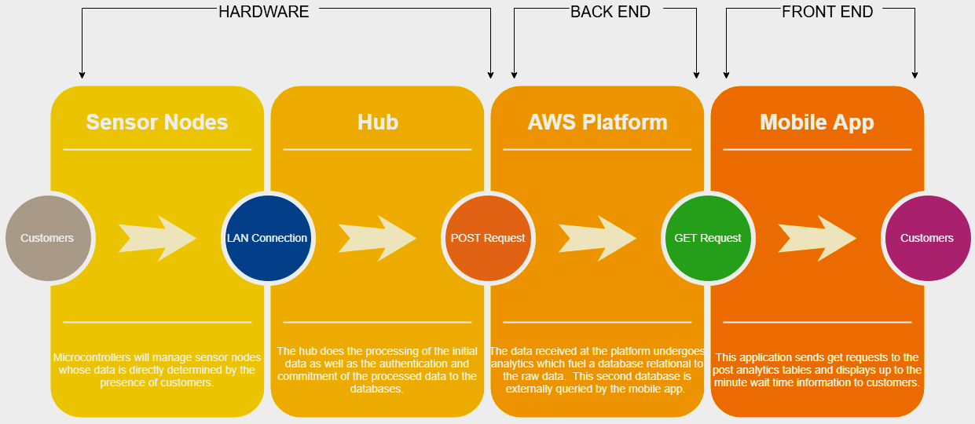
Integration Testing
Dummy Data
Similar Use-Case
Small Scale
Large Scale

Slide 13
Risks and Mitigations (Lessons Learned)
Expected Risk (491): Potential that our nodes don’t provide enough data for the level of analytics necessary to meet our functional requirements.
Level: Medium
Mitigations:
Using microcontrollers allows room for expandability
Large prototype phase allows experimentation
Post mitigation risk level: Low
Notes:
Our project has two main risks that we need to be aware of while prototyping. The first is whether or not our data collection components will generate enough data to create accurate predictions. This is still considered a risk to our project because although we have completed a lot of work on the data collection and communication pieces of our project, we have not fully transitioned into the software piece which deals with the actual predicition. Because of this, it is difficult to judge how much data we prefer to have to make predicitions that meet our functional requirements. Since we know we have created reliable data collection, this risk is considered a “medium” level. If we find that we need more data during our implementation next semester, we have two main mitigations. Since we are using microcontrollers that are able to handle more data than we are currently generating, we will not need to change the main components of our system if we need more data. Also, due to the fact that we have completed our data collection and communication during this semester, we will have ample time during the second semester to experiment and adjust if needed. Based on our current plan, this risk is considered low-level after considering our mitigations.

Slide 14
Risks and Mitigations (cont.)
Expected Risk: Unfamiliarity with AWS and Flutter may cause project to go off-schedule or certain features to become infeasible.
Level: Medium
Mitigations:
Both platforms have decided fallbacks we feel comfortable with
Android Studio as a Flutter fallback (4 team members have experience)
ECE managed servers as AWS fallback (3 team members have experience)
Post mitigation risk level: Low
Notes:
Our second risk that we need to consider during implementation is our unfamiliarity with some of the tools we are utilizing in our project. Our reasoning for selecting these tools was addressed earlier in this presentation, but these decisions do not come without risk. The main risk is being unable to implement some more advanced features, or the risk of falling behind schedule during the implementation. Luckily, these tools are widely used and our both created by reputable companies that have an ample amount of tutorials that will help us learn. Due to the amount of learning materials available, this risk is only medium level. However, if we are unable to create a product that meets our requirements using these tools, our planned mitigation is to fall back to platforms that we are more farmiliar with. Through previous projects we have completed, we have farmiliarity with android studio and servers managed by the university, which can act as replacements for Flutter and android studio respectively. With our current plan and our ability to adapt, this risk is considered low-level after considering our mitigations.

Slide 15
Unforeseen Setbacks
Timeline
Interdisciplinary development
Feature creep
Environmental testing

Slide 16
Projected Resource Cost
Cost projections were made assuming one table with four seats.
Hardware Per Table
Hardware Per Restaurant
Reference Number | Item | Cost per Unit x Number of Units | Total Cost
1 | NRF24L01 Transceiver | $1.19 x 5 | $5.95
2 | Infrared Proximity Sensor | $13.95 x 4 | $55.80
3 | Force Sensor | $14.99 x 4 | $59.96
4 | Elegoo Uno | $10.96 x 1 | $10.96
5 | Elegoo Nano | $5.00 x 4 | $20.00
 |  |  | Total: $152.67
Reference Number | Item | Cost per Unit x Number of Units | Total Cost
1 | NRF24L01 Transceiver | $1.19 x 1 | $1.19
2 | Raspberry Pi 3 Model B | $39.00 x 1 | $39.00
 |  |  | Total: $40.19
Projected PCB Cost
Reference Number | Item | Cost per Unit x Number of Units | Total Cost
1 | PCB | $4.43 x 10 | $44.30
Notes:
Meng: “did our due diligence, analyzed pricing, etc”

Slide 17
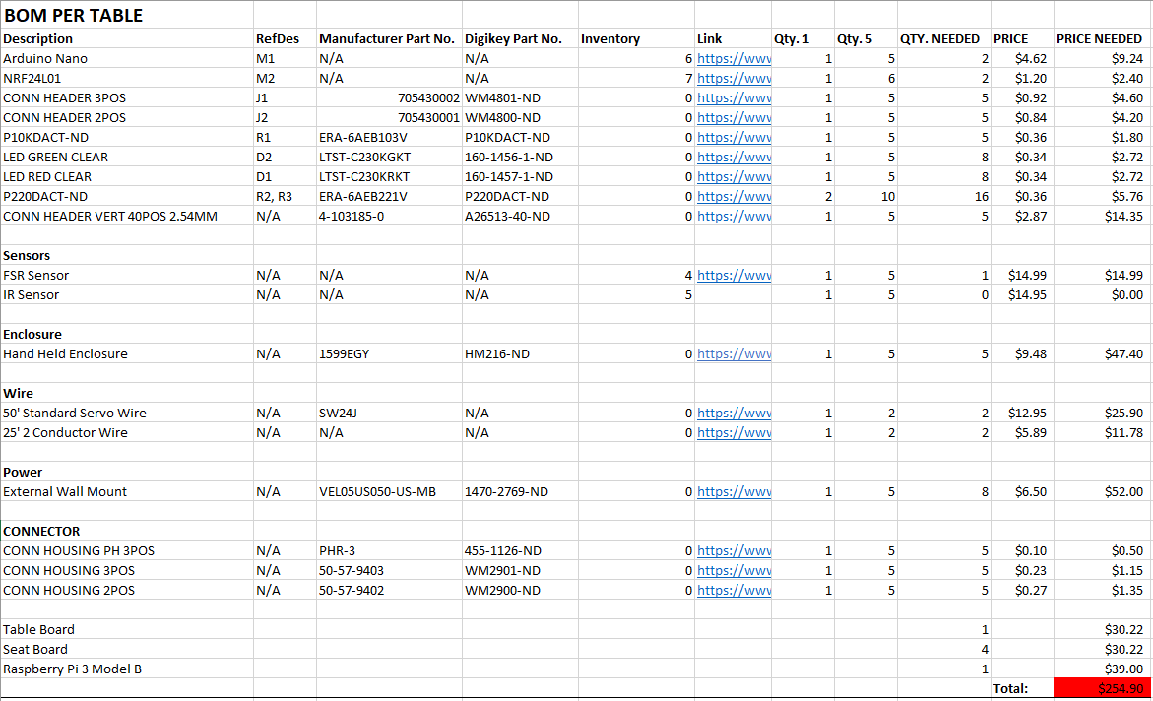
Actual Resource Cost
Notes:
Meng: “did our due diligence, analyzed pricing, etc”

Slide 18
Prototype Implementation (491)

Slide 19
Printed Circuit Board Implementation
Printed Circuit board design
Testing revision
Expandability
Networking
Enclosure development
Higher durability
Notes:
Mention that this contains the networking

Slide 20
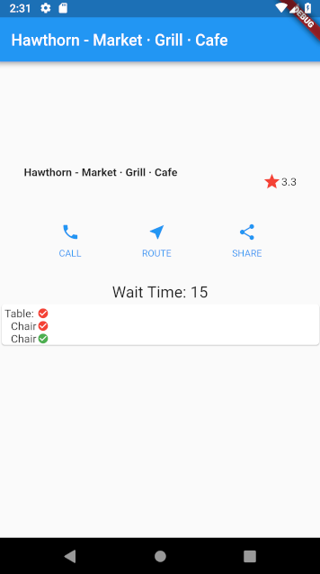
Post Prototype Implementation
Wait times
Statistical analysis of wait time factors
Restaurant finder
Pull all restaurants close to you
Search for a restaurant
Get rating information from Google
User profile support
Add favorite restaurants

Slide 21
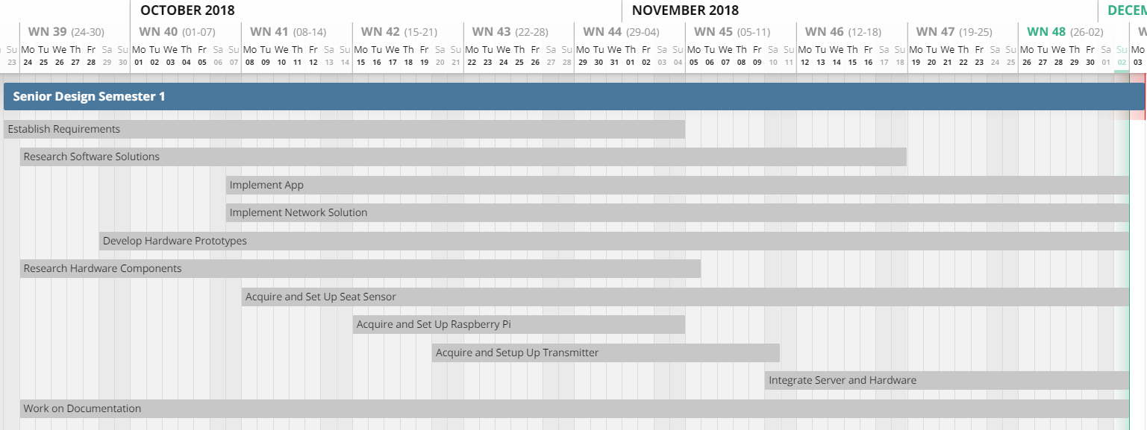
Planned Milestones and Schedule
Semester 1 Timeline
Semester end goal: Integrate hardware and software as proof of data collection/communication
Sub-milestones:
Communicate between node and hub
Transfer data to/from db
Notes:
Shane
This is our original plan for the schedule for the first semester
Our goal was to have each of our subsystems up and running with basic functionality and to start working on integration
The integration can be split up into two parts for this semester
Network Communication, between the hardware node and hub, and
Transferring data to and from the database from the hub

Slide 22
Planned Milestones and Schedule (cont.)
Semester 2 Timeline
Semester end goal: Deliver polished end product
Sub-milestones:
In-restaurant trial
Algorithm analysis and testing
Notes:
Shane
This was our expected plan for the second semester that we made in the first semester
Our goal was obviously to deliver a polished end product
To do that we to complete the integration testing and develop a prediction algorithm, then perform an in-restaurant trial

Slide 23
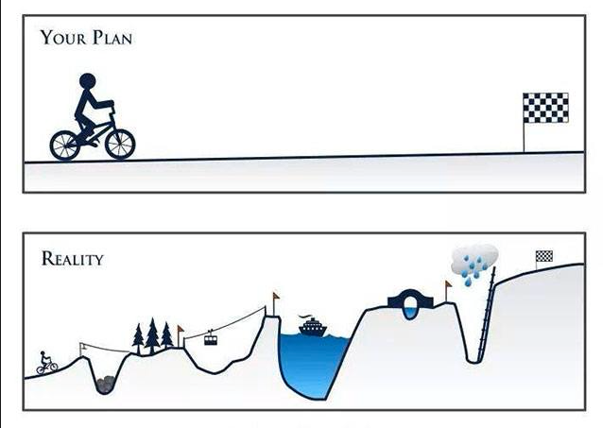
Actual Timeline
Hardware ahead of schedule
Freed certain team members
Backend redesign
Foreseen risk
Algorithm extended
Focal point
Room for expansion
Notes:
Shane
There are some differences in what we expected to what actually happened in the second semester
Another issue arose since we ideally wanted our hardware to be completed as soon as possible
Since we focused that quite a bit, we ended up having to refactor our schedule a bit to accommodate the hardware people
Turned out helpful,
One of the problems we ran into was with our initial server design
We didn’t design it as elegantly as we could have, it required a redesign, which took quite a bit of time and effort, it set back the server progress a bit
This was one of our foreseen risks, but by the time we realized it was an issue it was too late to mitigate it, we had to put in the work to get past it
The prediction algorithm that we use is basic statistical analysis of the data that we have
None of us had any experience in this area so our expectation for this step wasn’t really accurate
This is a focal point of our project, implementing it is quite involved
So there’s still some room to continue developing this further

Slide 24
Future Plans
Security
Potential misuse
Context expansion
Queueing integration
Logical but out of scope
Algorithm enhancement
Statistical analysis → Machine learning
Notes:
Shane
Security
We’re not security professionals, tried to choose best practices
User level vulnerabilities/abuse
DOS, Server security
Context expansion
We limited our scope, this is an occupancy detector though
We can make adjustments to adapt our core system to other similar applications
Queueueueing integ
Add yourself into a queue for a restaurant
Out of scope, is almost another project in itself
It’s a logical inclusion, but too much work for us
Algorithm Enhancement
We took a statistical approach
There is room for expansion into machine learning algorithms
Write script for this

Slide 25
Questions? Comments?
Suggestions?
Notes:
Shane

